Slide 1
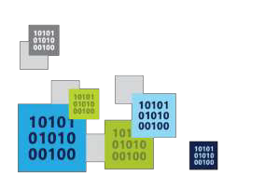
Intro to HoloLens Development
A new era of mixed reality
Trilok Chowdary
Program Manager
Codepixel

Slide 2
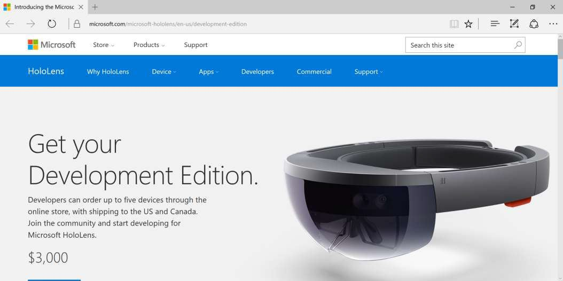
HoloLens Dev Kits are Shipping!
https://www.microsoft.com/microsoft-hololens/en-us/development-edition

Slide 3
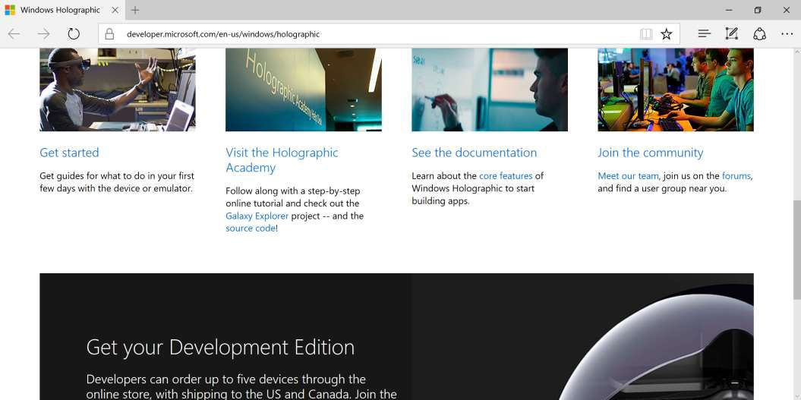
Start Here for Guides, Docs, Community
http://dev.windows.com/holographic

Slide 4
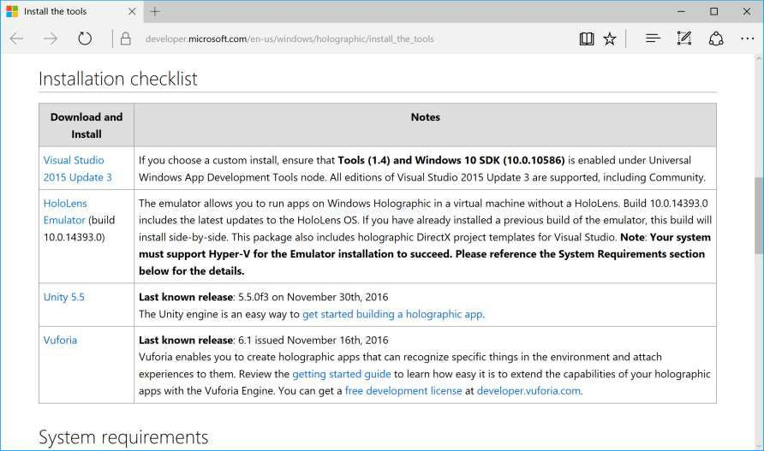
Install the Tools
Checklist
VS2015 + Update
Emulator
Unity
Vuforia
https://developer.microsoft.com/en-us/windows/holographic/install_the_tools

Slide 5
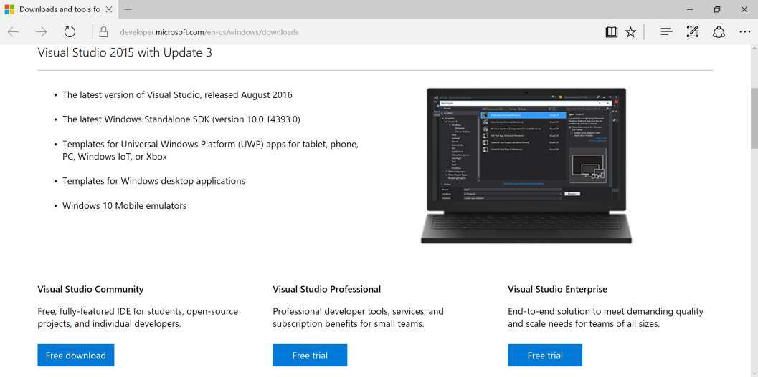
Visual Studio 2015 + Update
http://dev.windows.com/downloads

Slide 6
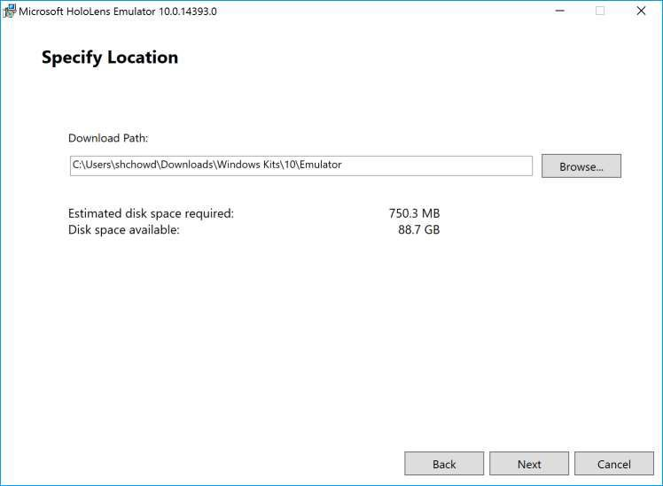
HoloLens Emulator
http://go.microsoft.com/fwlink/?LinkID=823018

Slide 7
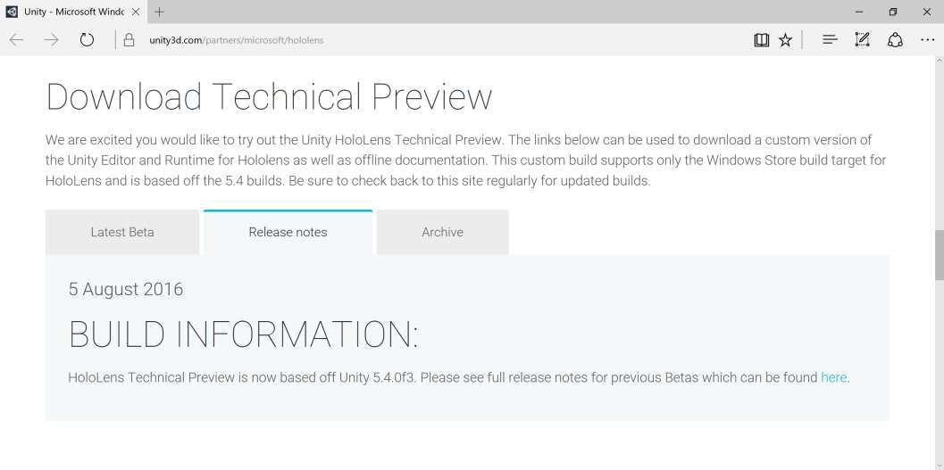
Unity HoloLens Technical Preview
https://unity3d.com/partners/microsoft/hololens

Slide 8
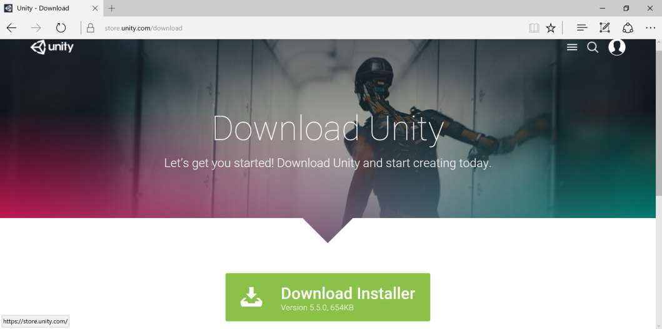
Unity Installer
https://store.unity.com/download

Slide 9
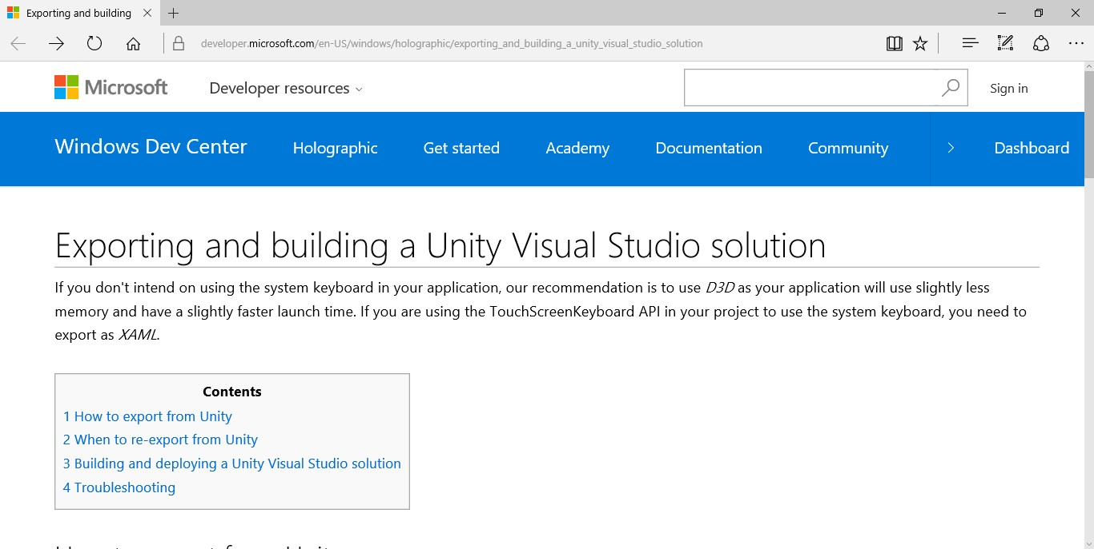
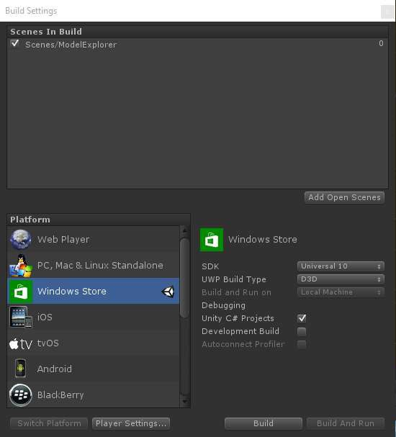
Exporting From Unity to Visual Studio
https://developer.microsoft.com/en-US/windows/holographic
/exporting_and_building_a_unity_visual_studio_solution

Slide 10
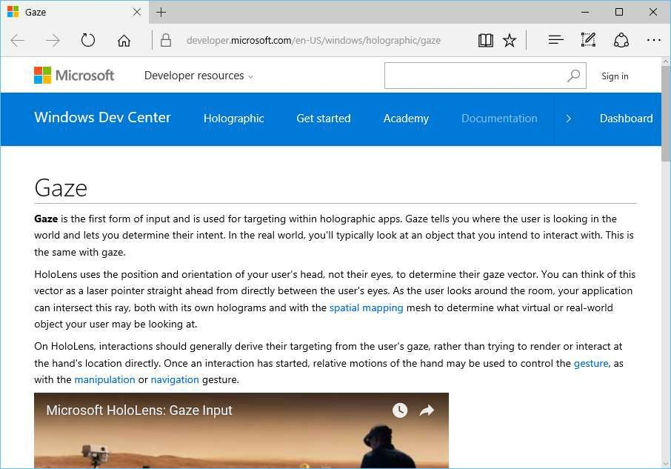
Gaze
What is Gaze?
Form of input
Real-world line of sight
Uses head, not eyes
Uses of Gaze
Intersect with holograms
Target gestures
Place holograms
Detect “away” objects
https://developer.microsoft.com/en-US/windows/holographic/gaze

Slide 11
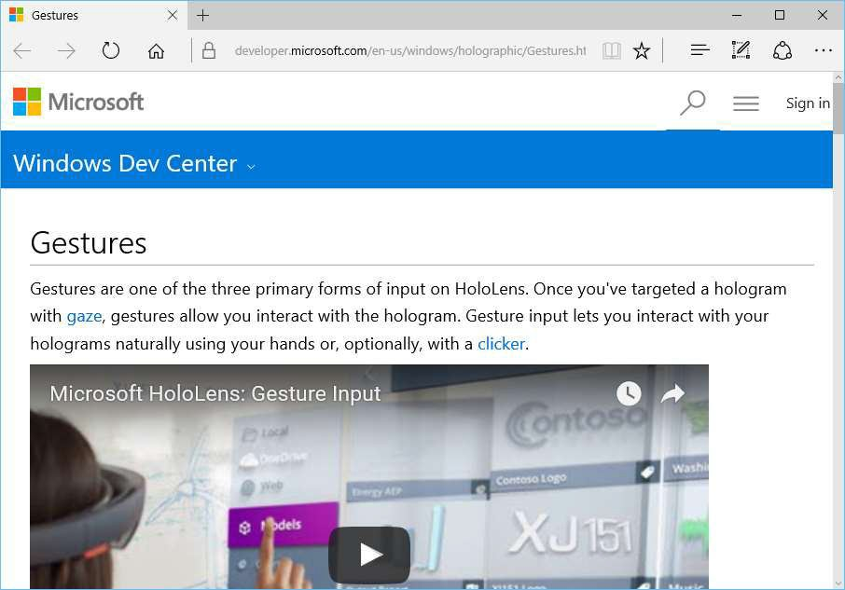
Gestures
What are Gestures?
Form of input
Use your hands/fingers
Use optional clicker
Uses of Gestures
Interact with holograms
Interact with apps
Interact with menu
https://developer.microsoft.com/en-us/windows/holographic/Gestures.html

Slide 12
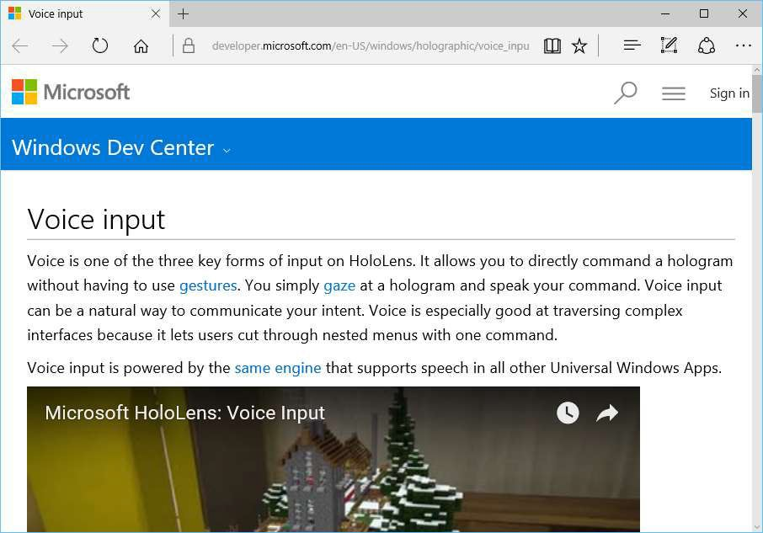
Voice Input
What is Voice Input?
Form of input
Powered by UWP speech engine
Uses of Voice Input
“Hey Cortana!”
Take photos/video
Command holograms
https://developer.microsoft.com/en-US/windows/holographic/voice_input

Slide 13
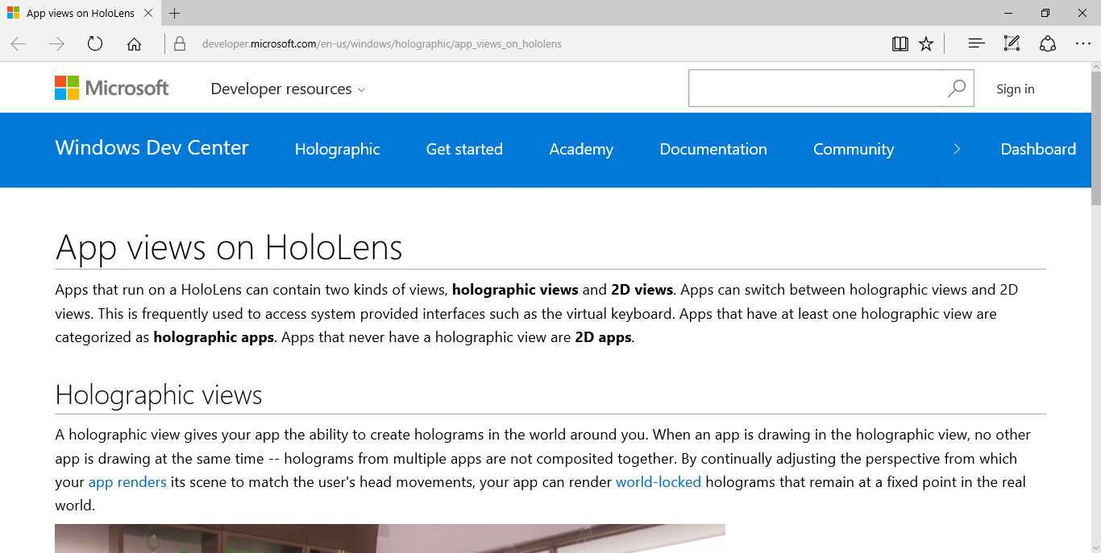
App Views: Holographic vs 2D
https://developer.microsoft.com/en-us/windows/holographic/app_views_on_hololens

Slide 14
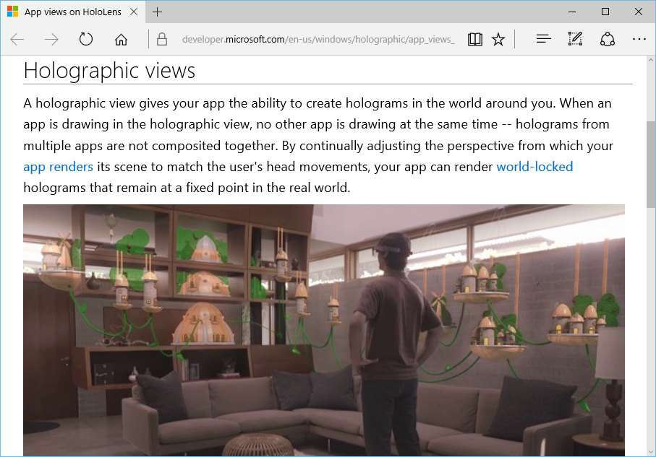
Holographic View
What is it?
View 3D holograms
One holographic app at a time
Lock to real world
https://developer.microsoft.com/en-us/windows/holographic/app_views_on_hololens

Slide 15
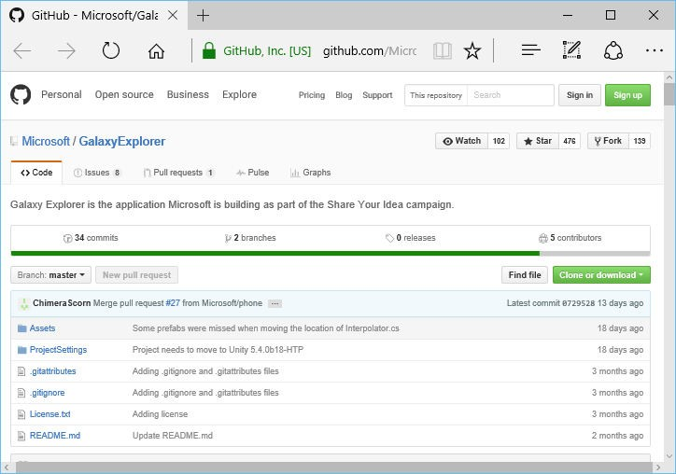
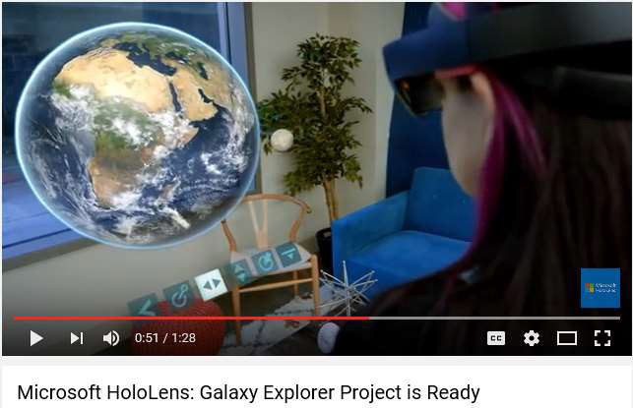
Galaxy Explorer: Open Source on GitHub
https://github.com/Microsoft/GalaxyExplorer

Slide 16
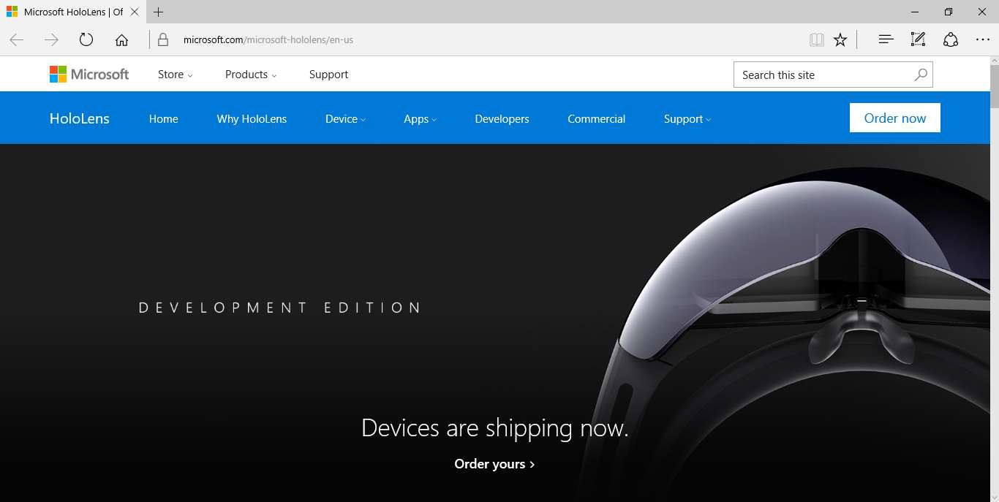
HoloLens: Official Website
http://hololens.com

Slide 17
Demo

Slide 18
Q & A

